Slide 1
Medical
Math
Notes:
PowerPoint with matching Listening Guide is long and comprehensive. A suggestion would be to teach it over several days and make assignments from the activities found in the unit as you go along.

Slide 2
Why is math important in healthcare?
Health care workers are required to perform simple math calculations when doing various tasks.
Mathematical errors may result in injury or a life or death situation.
Notes:
Teacher Notes:
Be aware that the first segment of this PowerPoint is designed as a simple, straightforward introduction to the metric system. BEFORE doing conversions, we want students to have a picture in their head of metric measures. When you mention a meter, they should be able to picture a meter stick – or the approximate distance from their toes to their waist. For each metric measure, you want them to be able to recall a mental picture.
Many learners have a fear of math, compounded with a fear of the metric system. If you move slowly and give them tools they can use, AND find ways to make this lesson enjoyable – you and your students will have fun, and success, learning the metric system.

Slide 3
Confidence with Numbers!
Whole numbers:
Non-whole numbers
Mixed numbers
Percentages:
Notes:
Whole numbers: The counting numbers and zero; they do not contain decimals or fractions.
Non-whole numbers: Numbers that have decimals ex: 12.25
Mixed numbers: Whole numbers and a fraction ex: 12 ½
Percentages: Represents part or all of something

Slide 4
Basic Math

Slide 5
Averages
Practice!
Here’s the sample
19, 20, 21, 23, 18, 25, and 26
Notes:
Sum: (19+20+21+23+18+25+26) = 152
Divide by 7 and get 21.7 (22)

Slide 6
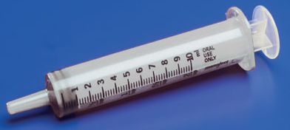
Health Care uses the Metric System
Why?
To align with the rest of the world
To assure accurate and consistent communication in a healthcare setting
Because it is based on 10s, you can do some calculations in your head!
Image from www.pocketnurse.com
Notes:
Teacher Notes:
Ask the question: “Why do we use the metric system?”
Encourage student responses before you reveal the three reasons given.

Slide 7
Basic rules to the Metric System
1. Use decimals, not fractions
Ex: 1/10 = 0.1
2. Write a 0 before a decimal.
Ex: .1 is 0.1
3. Abbreviations for metric terms are never plural.
Ex: grams is g, not gs

Slide 8
Prefixes make it simple!
What’s the pattern?
1 kilometer = 1,000 meters
1 hectometer = 100 meters
1 dekameter = 10 meters
1 meter
1 decimeter = 0.1 meter
1 centimeter = 0.01 meter
1 millimeter = 0.001 meter
Notes:
Teacher Notes:
This slide is designed to show the progression. We will focus on the measures most used in a healthcare setting.

Slide 9
Start with Length
Write and memorize!
1 kilometer = 1,000 meters
1 meter
1 centimeter = 0.01 meter
1 millimeter = 0.001 meter
Notes:
Teacher Notes:
Ask students to memorize these measures of length.

Slide 10
Make a Mental Picture
Track around football field = 400 meters
How far for a kilometer?
2.5 times
Kilometer
Meter
Centimeter
Millimeter
Meter: about floor to waist
Centimeter: width of index finger
Millimeter: thickness of fingernail
Notes:
Teacher Notes:
This slide prompts a group activity.
Divide students into pairs or small groups, each with a meter stick or ruler with cm and mm
Have them make a mental picture of a kilometer (2 ½ times around a football field)
For the remaining measures, they should use their body and the meter stick or ruler to get a mental picture of each measure. For example:
Meter – distance from the floor to my waist (obviously, this depends on the height of the student)
Centimeter – width of my index fingernail
Millimeter – thickness of my fingernail
Be sure they keep it clean!
Note: Having a mental picture of these measures can be a big help when students start doing conversion problems.

Slide 11
Length Practice!
How many millimeters in a centimeter?
How many centimeters in a meter?
How many millimeters in a meter?
How many meters in a kilometer?
How tall are you in meters (estimate)?
10
100
1000
1000
2
Notes:
Teacher Notes:
Have students write their answers on scrap paper before you show the correct answer.
Students should be able to answer these questions without difficulty.

Slide 12
What about weight?
1 kilogram = 1,000 grams
1 gram
1 milligram = 0.001 gram
Also referred to as mass.
Notes:
Teacher Notes:
Again, these equivalents should be memorized.

Slide 13
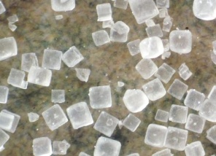
Make a Mental Picture
About the weight of a half-full 2-liter bottle.
Kilogram
Gram
Milligram
The plastic top weighs 2 grams
A can of soup contains 300 grams
Approximately 3 grains of salt.
Notes:
Teacher Notes:
The can of soup is 10 ¾ ounces or 305 grams. We rounded the mental picture to 300 grams to make it easier to remember and use for estimating.

Slide 14
Weight practice!
1000
How many milligrams in a gram?
How many grams in a kilogram?
How much did you weigh at birth in kilograms?
1000
Example: 7.5 lbs = 3.4 kg
Formula: lbs / 2.2 = kilograms
kg x 2.2 = pounds
Notes:
Teacher Notes:
Have students write their answers on scrap paper before you show the correct answer.
Students should be able to answer these questions without difficulty.
Ask them to guess the weight question, based on their experience holding a newborn, and how that weight compared to their mental picture of a half-full 2-liter soda bottle. Actually, a full 2-liter bottle is about 5 lbs

Slide 15
What about volume?
1 liter
1 milliliter = 0.001 liter
1 cubic centimeter (cc) = 1 milliliter (mL)
Notes:
Teacher Notes:
Point out that in healthcare, cc and mL are the same thing.
Also, the abbreviation for milliliter can be either mL or ml, whichever you prefer in your classroom. Healthcare professionals need to recognize both.

Slide 16
Make a Mental Picture
You already know the volume of a 2-Liter bottle
Liter
Milliliter
A can of soda is 240 mL
One teaspoon is 5 mL
Notes:
Teacher notes:
One again, you are trying to get students to make a few mental images so that they can call on these images when you play the estimation game.

Slide 17
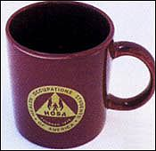
Volume practice!
How many milliliters in a liter?
How many milliliters in a coffee mug?
1000
240
Notes:
Teacher Notes:
Have students write their answers on scrap paper before you show the correct answer.
Students should be able to answer these questions without difficulty.
Note that a cup is 8 oz, although drinking cups come in many sizes. A standard size coffee mug comfortably holds 240 mL.

Slide 18
Now its time to get serious
Notes:
Teacher Notes:
Have students write their answers on scrap paper before you show the correct answer.
Students should be able to answer these questions without difficulty.
Note that a cup is 8 oz, although drinking cups come in many sizes. A standard size coffee mug comfortably holds 240 mL.

Slide 19
Converting Grams
Grams to milligrams – multiply by 1000 or move decimal three places to the right
0.15 g = _____ mg
0.150 g = 150 mg
0.15 g = 150 mg
Milligrams to grams– divide by 1000 or move decimal three places to the left
500 mg = _________ g
0.5
Notes:
Teacher Notes:
For the next 5 slides, have students write their answers (fill in the blank) on scratch paper, before you reveal the answer. Go slowly. Your goal is for ALL students to get these right.

Slide 20
Practice converting grams and kg
What would you do to convert grams to kilograms?
600 g = _________ kg
What would you do to convert kilograms to grams?
4.5 kg = _________ g
0.6
4500

Slide 21
Converting Meters
Meters to millimeters – multiply by 1000 or move decimal three places to the right
2.54 m = _____ mm
2.540 m = 2540 mm
Milliliters to liters – divide by 1000 or move decimal three places to the left
1650 mm = _________ m
1.65

Slide 22
Metric Quiz
0.25 g = ______ mg
1.5 m = _______ mm
3 mm = ________ m
10 cc = ________ mL
2 mg = _________ g
200 mL = _________ L
250
88 g = ________ kg
7.5 cm = _______ m
300 m = ________ km
10 kg = __________ g
40 mg = _________kg
6 L = _________ mL
0.088
1500
0.075
0.003
0.3
10
10,000
0.002
0.00004
0.2
6000
Notes:
Metric Quiz
Have students write their answers on notebook paper. You can either collect the quizzes, or let them grade them themselves. Clearly, the goal is 100% correct.
Give students as much time as they need.
Note: If you have any students who scored under 70%, offer some lunchtime or after school remediation. Start at the beginning and go back through this PowerPoint. Have students think out loud for you to help you figure out where they are slipping up. At the end of the day, ALL of your students should have an opportunity to be successsful in metric math.

Slide 23
Congratulations! Time to Convert Household Weight
1 ounce (oz) = 0.028 kg or 28 g
1 pound (lb) = 0.454 kg or 454 g
1 kg = 2.2 lbs
To convert lb to kg, divide the number of pounds by 2.2
145 lb ÷ 2.2 = 65.9 kg
To convert kg to lb, multiply the number of kilograms by 2.2
25 kg x 2.2 = 55 lbs
Notes:
Teacher Notes:
Ask students to take notes during this part.
Another option is to have them make flash cards as you go through each metric to household equivalent

Slide 24
Now You Try It - Weight
6 oz = ________ kg
220 lbs = _______ kg
1362 g = ________ lbs
4 kg = _______ lbs
16 oz = _______ g
280 g = ________ oz
O.336 kg = ________ oz
0.168
100
3
8.8
448
10
12
Notes:
Teacher Notes:
Have students write their answers on scratch paper. Let them use a calculator and their notes or flash cards.

Slide 25
Congratulations! Time to Convert Household Length
1 inch (in) = 0.025 meter (m) or 2.54 cm
How many mm in 1 in!
1 foot (ft) = 0.31 meter (m) or 30.48 cm
How many inches in a foot?
How many feet in a yard?
How many meters in a yard?
So…which is longer, a meter stick or a yard stick?
25.4
0.93
Notes:
Teacher Notes:
Ask students to take notes during this part.
Another option is to have them make flash cards as you go through each metric to household equivalent
NOTE – the last bullet seems like simple logic, but make sure ALL your students can visualize the concept. If you have a meter stick, show them!

Slide 26
Now You Try It - Length
6 in = ________ m
27.94 cm = _______ in
25 m = ________ in
400 ft = _______ m
15.24 cm = ______ ft
6 ft 2 in = ________ cm
50 m = ________ yards
0.15
11
1000
124
½
188
53.76
Notes:
Teacher Notes:
Have students write their answers on scratch paper. Let them use a calculator and their notes or flash cards.

Slide 27
Congratulations! Time to Convert Household Volume
1 milliliter (mL) = 1 cubic centimeter (cc)
1 teaspoon (tsp) = 5 milliliters (mL)
1 tablespoon (tbsp) = 15 milliliters (mL)
1 ounce (oz) = 30 milliliters (mL)
1 cup = 8 oz = 240 mL
1 pint (pt) = 16 oz = 500 mL
1 quart (qt) = 32 oz = 1000 mL = 1 Liter (L)
Notes:
Teacher Notes:
Ask students to take notes during this part.
Another option is to have them make flash cards as you go through each metric to household equivalent

Slide 28
Isn’t That Funny Math?
If 1 cup = 240 mL, and 2 cups equal one pint…
Shouldn’t 1 pint = 480 mL instead of 500 mL?
Why the funny math?
The conversions aren’t perfect, but the medical community accepts the conversions we gave you on the previous slide.
Notes:
Teacher Notes:
Pause after the 3rd bullet and ask students to think it through and suggest possibilities before you show the 4th bullet.

Slide 29
Now You Try It - Volume
4 mL = ________ cc
20 tsp = _______ mL
20 mL = _______ tsp
4 oz = _______ mL
750 mL = _____ cups
64 oz = ________ pts
9 qts = ________ L
4
100
4
120
3
4
9
Notes:
Teacher Notes:
Have students write their answers on scratch paper. Let them use a calculator and their notes or flash cards.

Slide 30
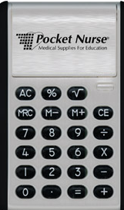
Congratulations! Time to Convert Temperature
Fahrenheit (F) to Celsius (C) = ⁰F- 32 x 0.5556
Celsius (C) to Fahrenheit (F) = ⁰C x 1.8 + 32
If you memorize those two formulas, temperature conversion is fairly easy.
Get out your calculators!
Notes:
Teacher Notes:
Ask students to take notes during this part.
Another option is to have them make flash cards as you go through each metric to household equivalent

Slide 31
Now You Try It - Temperature
260 ⁰F = _______ ⁰C
32 ⁰F = _______ ⁰C
102.6 ⁰F = _______ ⁰C
8 ⁰C = _______ ⁰F
32 ⁰C = ______ ⁰F
0 ⁰C = _______ ⁰F
126.7
0
Round to the nearest tenth
39.2
46.4
89.6
32
Notes:
Teacher Notes:
Have students write their answers on scratch paper.
Let them use a calculator and their notes or flash cards.

Slide 32
24 hour clock
Military or international time
Conversion: Write 00 as the first two digits to represent the first hour after midnight.
Write 01, 02, 03 . . . 11 as the first two digits to represent the hours 1:00 a.m. through 11:00 a.m.
Add 12 to the first two digits to represent the hours 1:00 p.m. through 11:00 p.m., so that 13, 14, . . . 23 represent these hours.
Write noon as 1200, and write midnight as 0000 for international time.

Slide 33
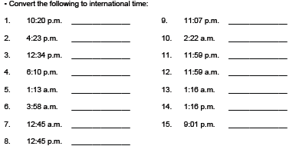
24 hour clock

Slide 34
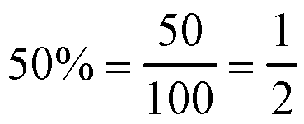
Percents
A percent indicates a value equal to the number of hundredths.
Changing a Percent to a fraction:
Drop the percent sign (%)
Write the number as the numerator
Write 100 as the denominator
Reduce to lowest terms

Slide 35
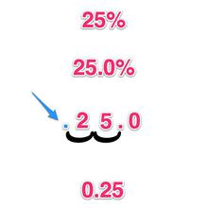
Percents (cont.)
Changing a Percent to a decimal:
Drop the percent sign (%)
Divide by 100 (by moving the decimal point two places to the left)
Express the quotient as a decimal.

Slide 36
Percents (cont.)
Finding Percentages of Numbers:
Write the number after the word of as the denominator.
Write the other number as the numerator.
Divide the numerator by the denominator.
Multiply by 100
Add the percent sign (%)
Example: What is 35 of 90?
Write as a fraction: 35/90
Divide numerator by denominator: 35 ÷ 90 = .39
Multiply by 100, add percent sign: .39 x 100 = 39%

Slide 37
Now You Try It - Percents
Change a percent to a fraction:
25% = ___________
75% = ___________
90% = ___________
Change a percent to a decimal:
66% = ___________
104% = ___________
Find percent of a number:
55 of 60 = ________
75 of 85 = ________
6 of 120 = ________
1/4
3/4
9/10
.66
1.04
92%
88%
5%

Slide 38
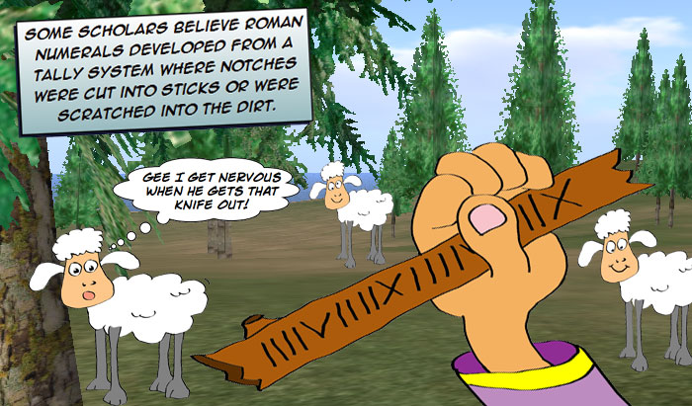
Roman Numerals
Roman Numerals origination
Many people believe Roman Numerals began as a tally system used by shepherds to keep track of how many sheep they had.
Each sheep was counted with a single notch cut into a stick with a knife. Every fifth sheep was recorded with two notches to form a V and then each tenth sheep was denoted by an X.

Slide 39
Roman Numerals
Reading Roman Numerals
M=1000, D=500, C=100, L=50, X=10, V=5, and I=1
The letters are arranged from left to right in descending order of valuation and are simply added to each other.

Slide 40
Roman Numerals (cont.)
Sometimes there’s a lower value numeral in front of (to the left of) a higher value numeral to indicate that the lower value should be subtracted from the adjacent higher value.
The subtraction rule is particularly useful to avoid four or more identical, consecutive numerals. For example, instead of writing IIII, we write IV.

Slide 41
Now You Try It – Roman Numerals
Rewrite the following:
4 = ________
7 = ________
16= ________
XVIII = ________
XIX = ________
XI = ________
IV
VII
XVI
18
19
11

Slide 42
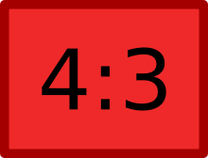
Ratios
A ratio indicates a relationship between two numbers.

Slide 43
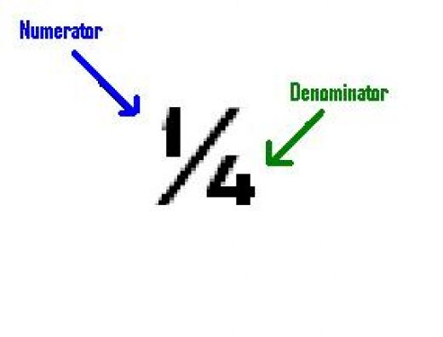
Ratios (cont.)
4/16
1:4
Changing a fraction to a ratio
Reduce to lowest terms
Write the numerator of the fraction as the first number of the ratio
Place a colon after the first number
Write the denominator of the fraction as the second number of the ratio

Slide 44
Ratios (cont.)
Changing a percent to a ratio
Express the percent as a proper fraction reduced to lowest terms
Write the numerator of the fraction as the first number of the ratio.
Place a colon after the first number.
Write the denominator of the fraction as the second number of the ratio.
Example: Percent as fraction: 25% = 25/100
Reduced : ¼
As a ratio: 1:4

Slide 45
Now You Try It – Ratios
Change the following fractions to a ratio:
5/25 = ___________
8/24 = ___________
Change the following percents to a ratio:
30% = ___________
68% = ___________
15% = ___________
1:5
1:3
30/100 = 3/10 = 3:10
68/100 = 17/25 = 17:25
15/100 = 3/25 = 3:25

